Slide 1
HEALTHCONNECT RWANDA
Healthcare Operations and
Performance Analytics
CURRENT
IMPLEMENTATION
40
Executive Presentation
SQL analyses
6 Power BI pages
AnalystLab Africa Week 6 · Data Analytics Track
27 October 2026

Slide 2
Executive snapshot
Current source totals and the principal decision risks
20,000
5,000
20
350
2.99 / 5
Registered patients
Recorded appointments
Facilities represented
Doctors
Avg. satisfaction
RWF 8.389B
RWF 919.95M
90.12%
55K
Collected payments
Outstanding billing
Collected / billed
Missing appointment parents
• Most source totals are usable, but facility-, department- and date-level attribution is constrained by incomplete appointment coverage.
• Financial concepts must remain separate: billed value, collected payments, claims and the monthly revenue summary have different scopes.
• Priority actions are appointment recovery, balance reconciliation, facility/department master validation and better dated operational data.

Slide 3
Project scope and implementation
The current SQL and PBIX are treated as the primary technical artifacts
SQL
Power BI
Data interpretation
MySQL / MySQL Workbench
• Executive Dashboard
• Preserve unmatched records instead of inventing parent attributes
• Database: HEALTHCARE_ANALYTICS
• Patient Analytics
• 40 analyses across patient, appointment, clinical and financial topics
• Treat province as patient residence, not facility geography
• Clinical Analytics
• Financial Dashboard
• Do not infer active insurance coverage from InsuranceID alone
• Includes an explicit service-level revenue limitation to avoid duplicated attribution
• Operational Dashboard
• Keep transaction totals separate from reported monthly revenue until scope is reconciled
• Uses MySQL functions such as MONTHNAME()
• Patient Experience Dashboard
Guide difference: the assignment requests PostgreSQL and a PostgreSQL backup. The actual implementation remains MySQL and is documented as such.

Slide 4
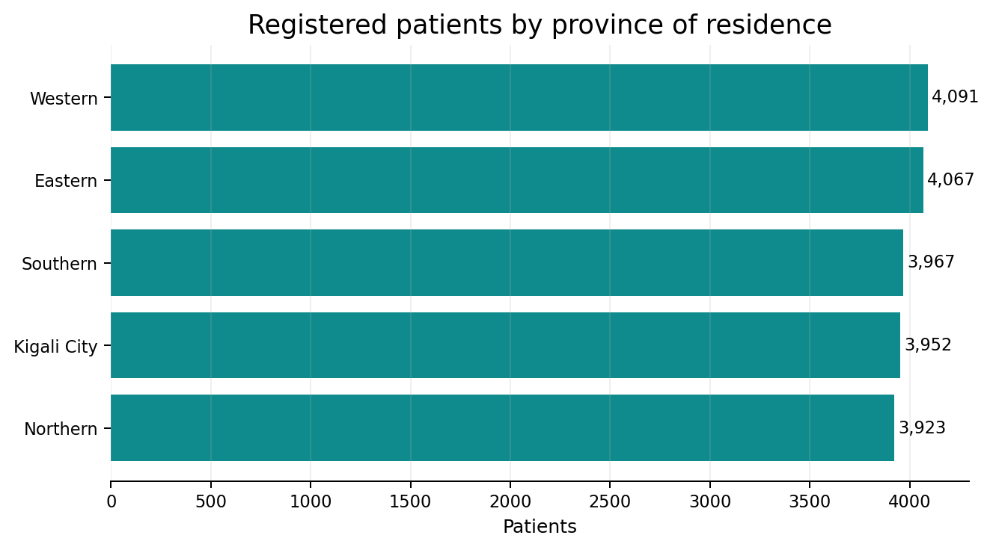
Patient profile
Registration characteristics across the supplied patient master
10,090
9,910
Male patients
Female patients
45.03
27.44%
Average age
Age > 65
74.65%
Recorded chronic condition
The top chronic conditions in the patient register are asthma (4,996), hypertension (4,988) and diabetes (4,945). These counts describe registration data, not attendance or population prevalence.

Slide 5
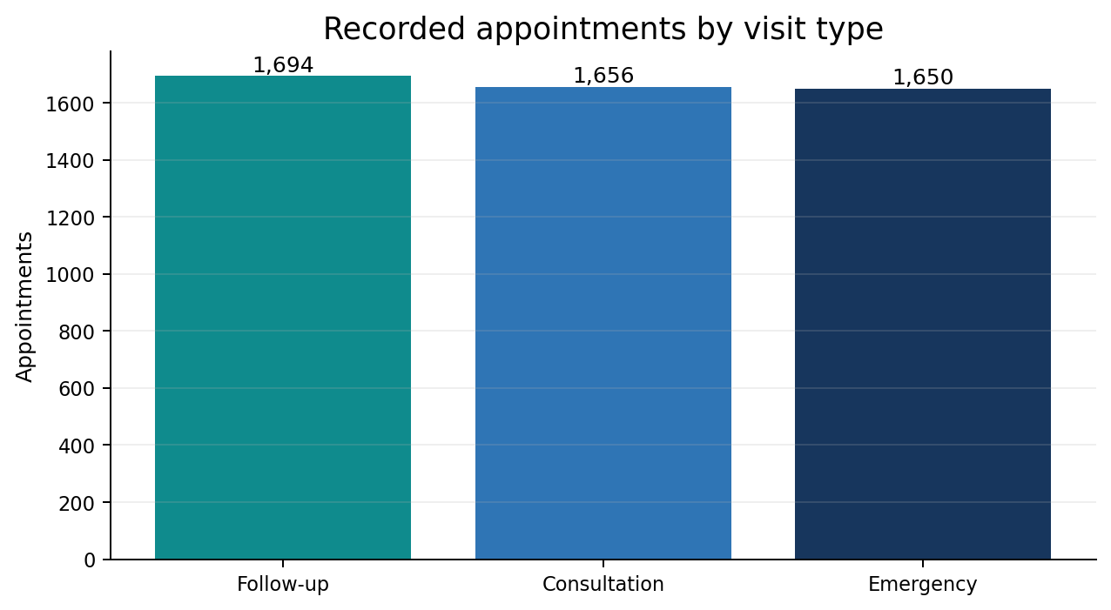
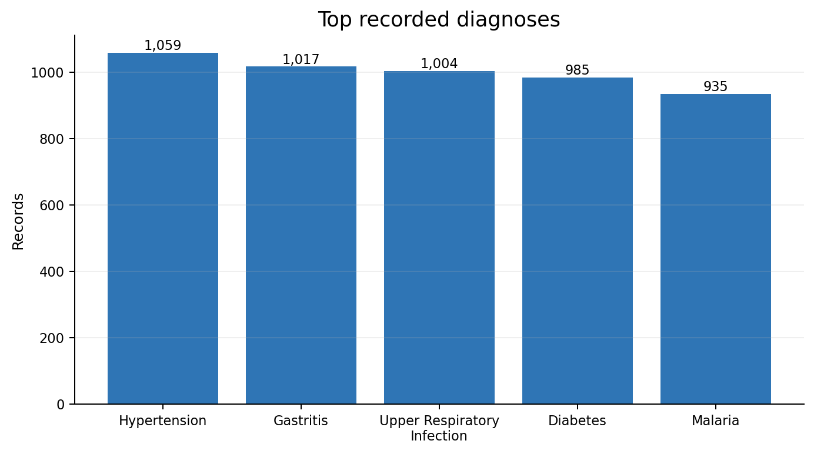
Recorded service demand and clinical activity
Core patterns from the current appointment and clinical files
1,272
1,068
5.49 days
4,708 referrals
Malaria lab tests
Amlodipine prescriptions
Average admission stay
415 linked to appointments
Monthly recorded appointments range from 400 (May) to 440 (March).

Slide 6
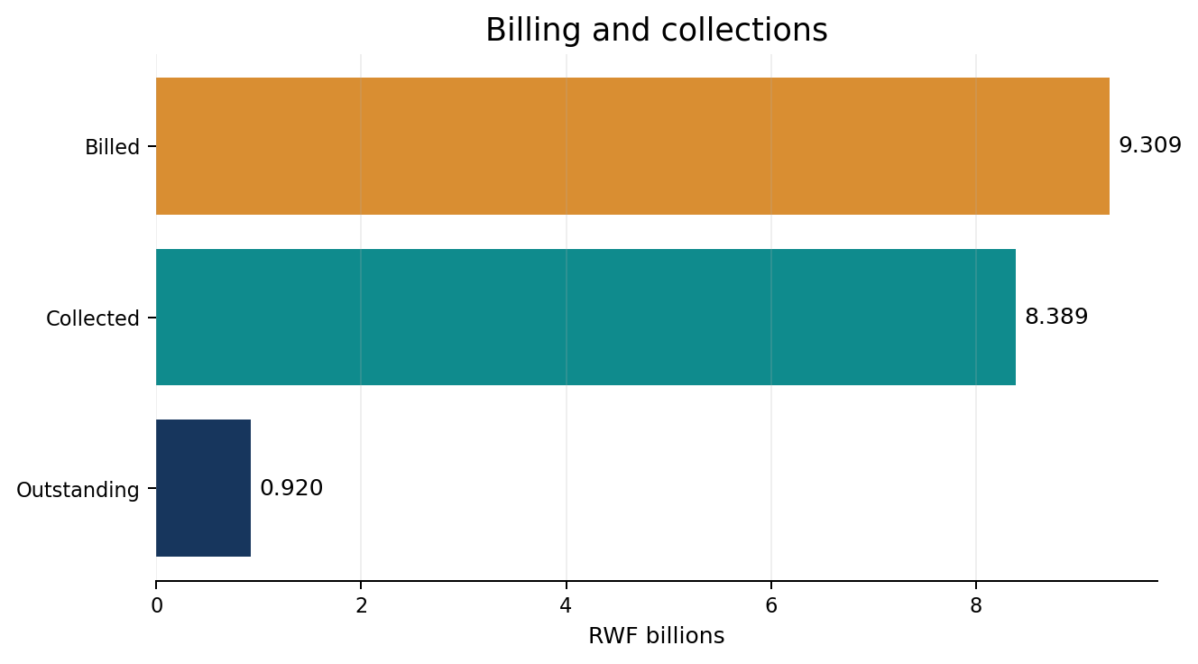
Financial performance
Collections are strong, but reconciliation and scope remain critical
RWF 9.309B
RWF 8.389B
Total billed
Collected
11,887
RWF 155,157
Bills with balance
Average bill
39,961
Billing-status discrepancies vs. strict money rule
• Insurance claims total RWF 4.882B; 21,008 are approved and 21,028 pending.
• Expense data are absent, so profit and operating margin cannot be calculated.

Slide 7
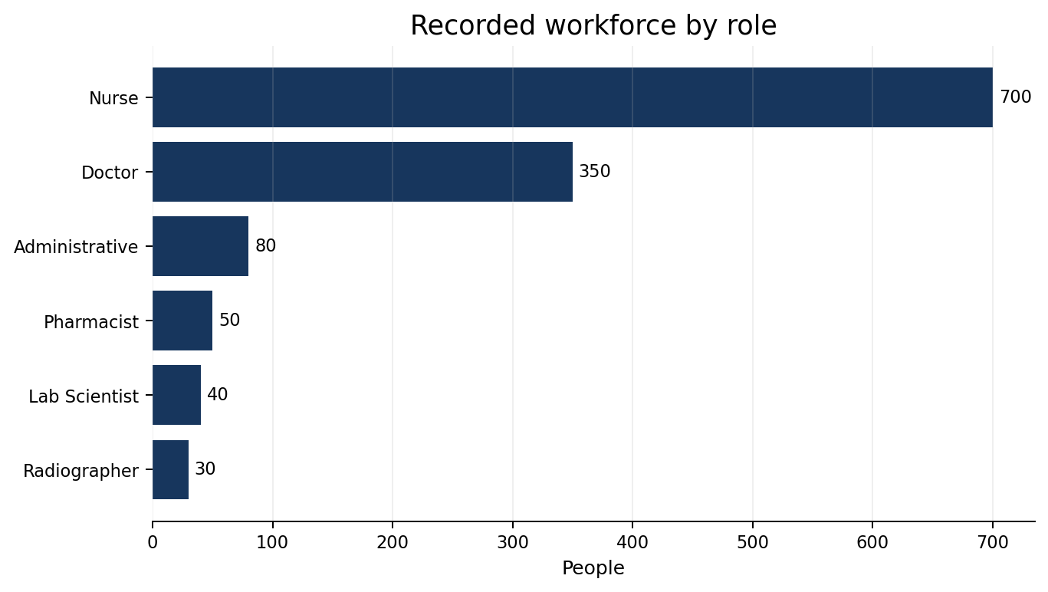
Operations and capacity
Staffing can be profiled; true utilization needs dated activity records
1,250
2,000
Unique staff
Beds
200
0%
Equipment records
Status-based bed occupancy
All beds are marked Available. Without dated occupancy events, the 0% status-based rate does not measure actual utilization over time.
Equipment utilization cannot be calculated because usage hours and available operating-time denominators are not supplied.

Slide 8
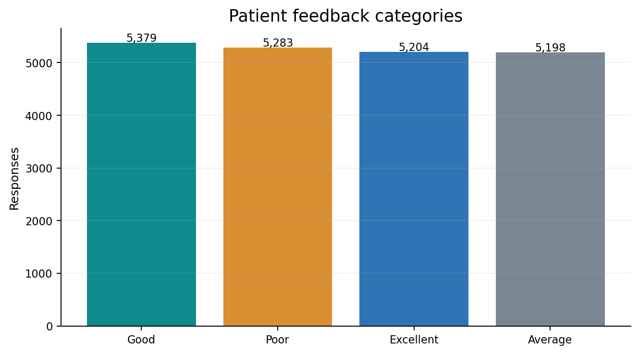
Patient experience
Feedback volume is broad, but facility and department rankings use a small linked subset
21,064
2.99 / 5
Feedback records
Average rating
5,283
25.08%
Poor responses
Poor share
1,756 linked
8.34% of feedback
The feedback file has no response date or formal complaint flag. A monthly “Poor” trend can only use linked appointment month as a proxy (422 records).

Slide 9
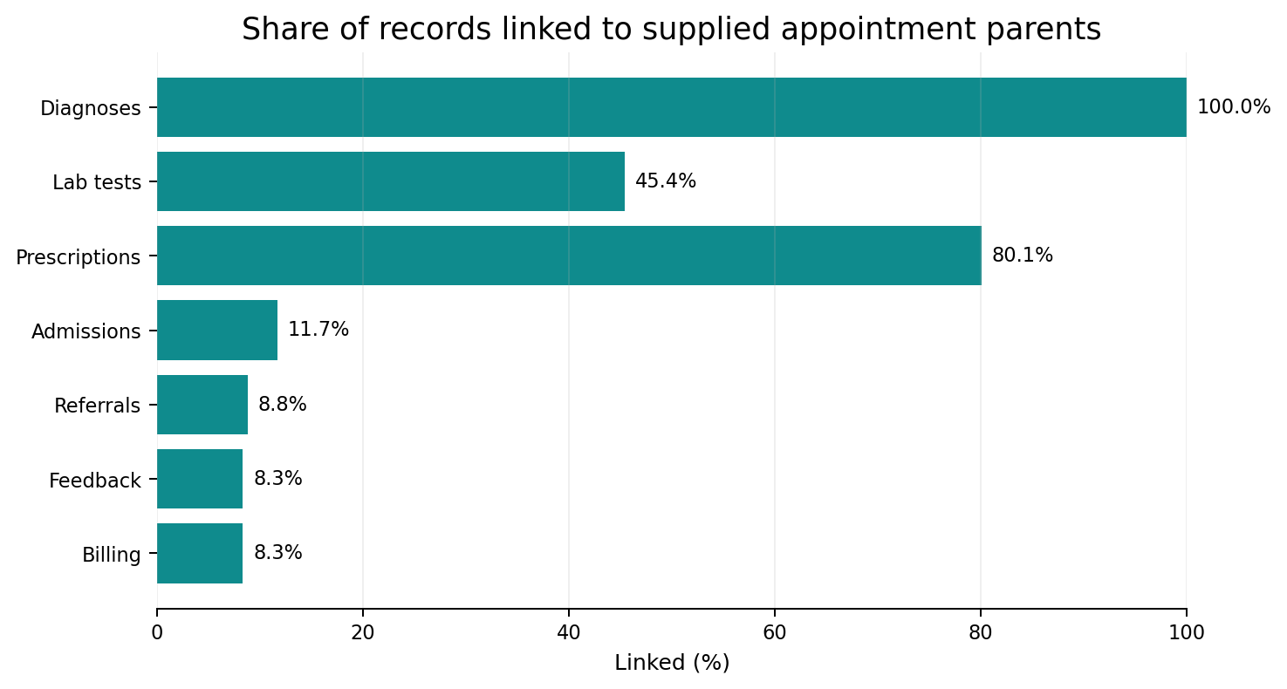
Data linkage is the main analytical constraint
Many downstream records reference appointment IDs that are absent from the supplied parent table
5,000
Appointment parent records
60,000
Distinct appointment IDs observed across sources
55,000
Additional referenced IDs without parent details
Use overall totals from each source table. For any facility, department, patient or date breakdown that requires appointment attributes, keep unmatched records as Unknown rather than dropping or inventing values.

Slide 10
Current SQL and Power BI coverage
What the submitted technical artifacts currently implement
SQL block | Questions | Coverage
Patient | 1–10 | demographics, chronic disease, insurance, age, duplicates
Appointments | 11–20 | month, workload, referrals, emergency, province, peak periods
Clinical | 21–30 | diagnoses, tests, medications, admission, referrals, department workload
Financial | 31–40 | facility/department revenue, claims, balances, billing, methods, ranking
Power BI pages
Executive
KPI cards + facility/department slicers
Patient
age, gender, province, chronic conditions, insurance/claims
Clinical
diagnoses, tests, prescriptions, referrals
Financial
monthly revenue + facility/department collected payments
Operational
staff matrix, facility patient volume, department appointments, capacity card
Experience
rating, feedback categories, hospital ranking
Do not claim unverified advanced Power BI features. The package confirms the six pages and core visual types, but not full implementation of every guide-listed advanced feature.
Service-level revenue is intentionally excluded in SQL because ServiceID is not linked to appointment or billing grain.

Slide 11
Recommended priorities
Actions that improve both decision quality and future analytics
1
Recover complete appointment export
Rerun linkage, facility, department and time-based analyses after the parent table is complete.
2
Reconcile finance rules
Resolve the RWF 919.95M balance and 39,961 status differences with documented settlement definitions.
3
Validate master-data assignments
Resolve 1,187 staff and 4,744 appointment facility/department conflicts against an authoritative master.
4
Capture dated operational data
Add bed occupancy events, equipment activity and timestamped feedback/complaints.
5
Add service usage keys
Record ServiceID at appointment or billing grain to support reliable service-level revenue.

Slide 12
Submission readiness and conclusion
Current artifacts are usable; remaining guide items should be handled transparently
Ready in this package
Still required / external to this package
• Current MySQL SQL analysis script
• Executive Dashboard PDF exported from the current PBIX
• Current six-page Power BI dashboard
• Cleaned / validated datasets in the final repository
• Business Insights Report (3–5 pages)
• PostgreSQL backup if strict compliance with the guide is required
• Executive Presentation (10–15 slides)
• GitHub repository link, if applicable
• README / project documentation
Management takeaway: the current analysis is strong enough to support directional patient, clinical, operational and financial insights, but the complete appointment parent table and finance reconciliation are the two highest-value data improvements.

